Slide 1
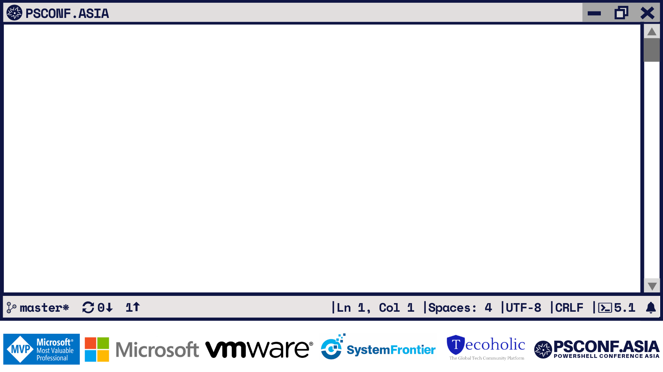

Ben Gelens / Jaap Brasser
7.0

Slide 2
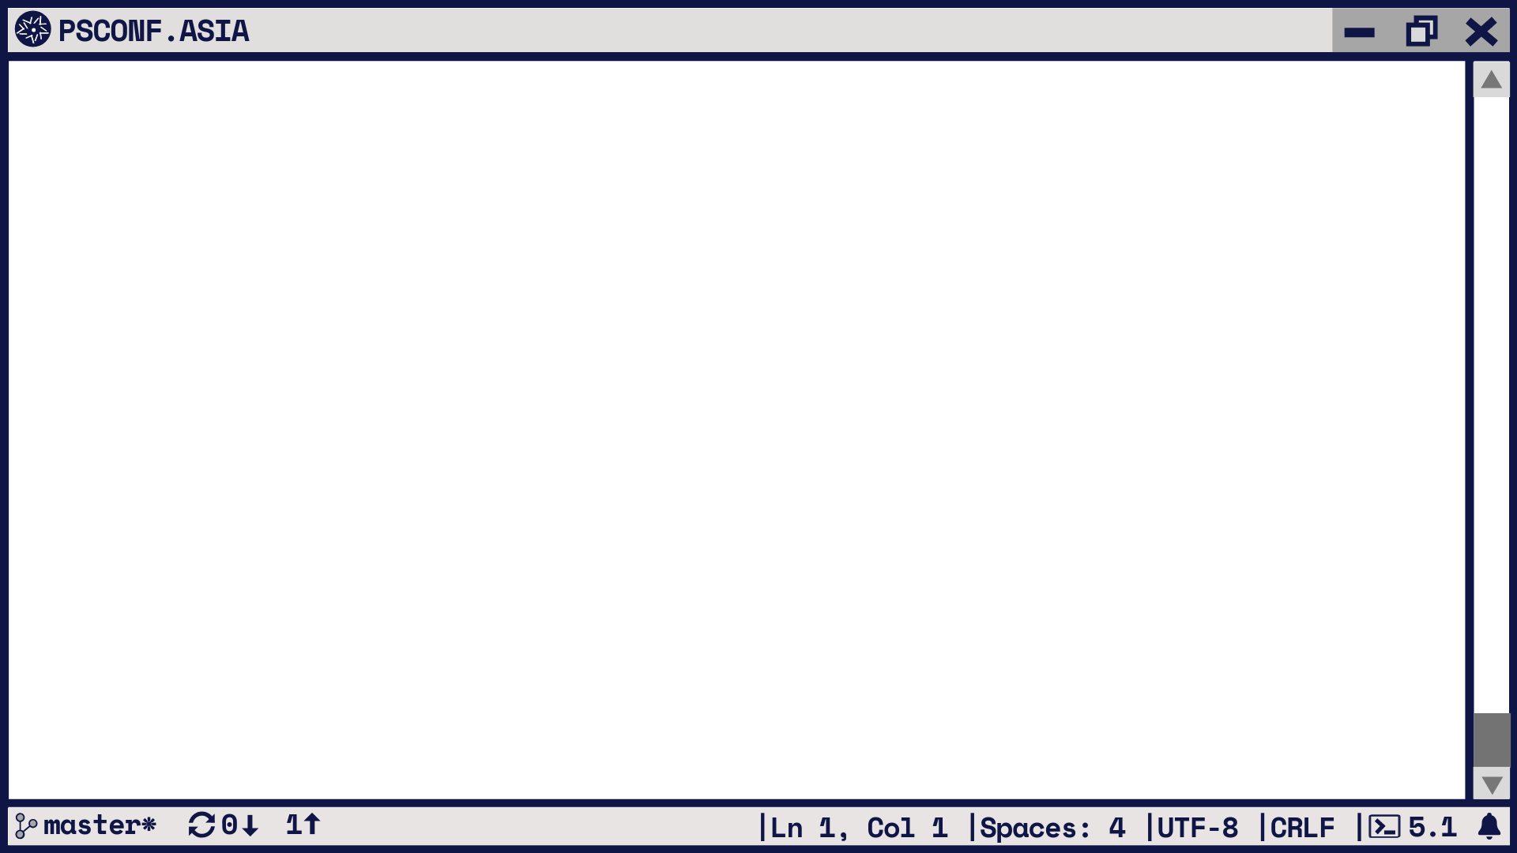
Agenda
Introduction to error handling
Debugging in PowerShell
Demo – Debugging your code
Questions
7.0

Slide 3
Error Handling
Terminating errors
Try – Catch – Finally
$Error
Handling Errors

Slide 4
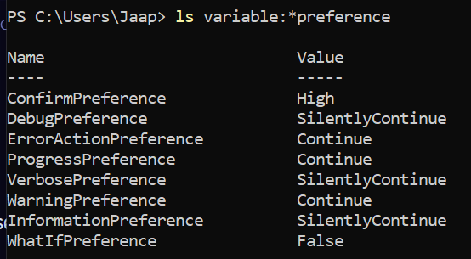
*Preference

Slide 5
Error handling features
$?
Trap {}
-ErrorAction Stop, Break
-ErrorVariable
$LastExitCode

Slide 6

Error handling with PowerShell
Demo

Slide 7
Debugging in PowerShell
Wait-Debugger
Set-PSBreakPoint
Attach Debugger
Set-PSDebug

Slide 8
PowerShell Debugging
Demo

Slide 9

Questions?

